Slide 1
NAME: M.GEORGE AARNISHA REG NO: 962821205020 DEPT: INFORMATION TECHNOLOGY
Final Project
3/21/2024 Annual Review

Slide 2
PROJECT TITLE
OBJECT DETECTION
3/21/2024 Annual Review

Slide 3


AGENDA
Introduction
Background
Data Collection and Preprocessing
Training and Evaluation
Deployment and Integration
User Interface Development
Conclusion
3/21/2024 Annual Review

Slide 4

PROBLEM STATEMENT
Given an image or video, develop a system that can identify and locate all instances of objects of specific classes.
This typically involves two key aspects:
Object Classification:
The system needs to correctly classify the object into a predefined category (e.g., car, person, dog).
Object Localization:
The system needs to draw a bounding box around each detected object, indicating its precise location within the image or video frame.
3/21/2024 Annual Review

Slide 5

PROJECT OVERVIEW
Object detection is a computer vision task that involves identifying and localizing objects within an image or video frame. It is a fundamental problem in computer vision with numerous applications across various domains, including surveillance, autonomous driving, medical imaging, retail, and more.
Localization: Object detection begins with locating objects within an image or video frame. This involves predicting the coordinates of bounding boxes that enclose the objects of interest.
Classification: Once objects are localized, the next step is to classify them into predefined categories or classes. Each bounding box is associated with a class label indicating the type of object it contains.
3/21/2024 Annual Review

Slide 6

WHO ARE THE END USERS?
The end users of object detection systems vary depending on the specific application and industry.
Surveillance and Security
Autonomous Vehicles
Retail
Agriculture
Environmental Monitoring
3/21/2024 Annual Review

Slide 7

YOUR SOLUTION AND ITS VALUE PROPOSITION
The solution and its value proposition for object detection depend on the specific application and requirements
Accurate Detection: The solution should accurately identify and localize objects within images or video frames, enabling users to reliably detect and analyze objects of interest.
Value Proposition: Accurate object detection reduces false positives and ensures reliable identification of objects, leading to better decision-making and improved outcomes in various applications such as security, retail, and autonomous vehicles.
Real-time Processing: The solution should be capable of processing images or video streams in real-time, providing timely detection and response to dynamic environments.
Value Proposition: Real-time object detection enables proactive monitoring, rapid intervention, and timely decision-making, enhancing situational awareness and responsiveness in applications like surveillance, traffic management, and industrial automation.
3/21/2024 Annual Review

Slide 8

THE WOW IN YOUR SOLUTION
Accurate Detection:
Imagine a solution that can accurately identify objects even in complex and cluttered scenes with high precision, providing users with confidence in the reliability of the detections.
2. Real-time Processing:
Picture a system that can process video streams in real-time, instantly detecting objects as they appear, enabling immediate response and action in dynamic environments.
3/21/2024 Annual Review
8

Slide 9
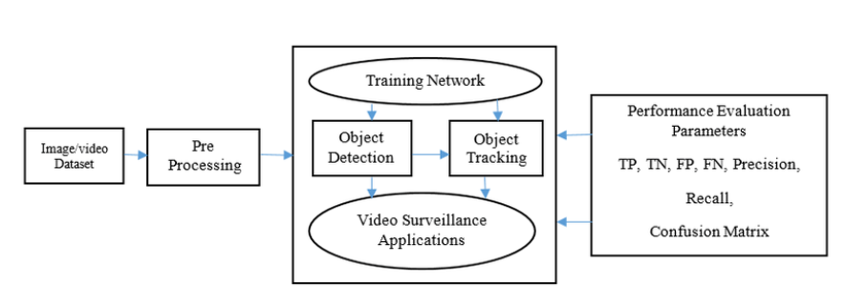
MODELLING
3/21/2024 Annual Review
9

Slide 10
RESULTS
The result of an object detection system would depend on the specific application and the quality of the input data.
Visual Output: The system might display the original image or video frame with bounding boxes drawn around detected objects. Each bounding box would be accompanied by a class label indicating the type of object it contains (e.g., "car", "person").
Data Output: The system might generate a report containing details about each detected object.
Surveillance systems: Identifying suspicious activity or tracking objects of interest.
Facial recognition: Identifying people in images or videos.
The effectiveness of the results will depend on factors like the quality of the training data, the chosen algorithms, and the computational resources available.
Demo Link
3/21/2024 Annual Review
10

